Slide 1
I/O Principles of I/O Hardware

Slide 2
Review
File System
Manages the information stored and hides the complexity on the storage devices
Provides the users access information in a convenient way and a uniform logical view
Is stored on disks
Implementations
File: Contiguous, Linked List, Linked List using a Table in Memory (FAT), i-nodes (same as multi-level paging)
Directory: Fixed size entries, one per file containing file name & attributes
File Name: fixed size, part of block, stored in heap
Utilities:
LFS (write data to end the log and using cleaner thread)
JFS (store log file and using atomic transaction)
VFS (uniform logical view for file system)
Disk Space management
Manage free block – linked list and bitmap
Disk quota: two tables contain open file and user quotas

Slide 3
Review
File System
Implementations
Utilities:
Disk Space management
File consistency: two array, one for block in use, other for free block
Directory consistency: counter file and traversal i-node
Backups, performance – caching
Block read ahead: load block k + 1 to memory when the block k is accessed
Reduce disk arm motion, defragmentation
File
Abstraction, Object and Mechanism
Name, Path (absolute vs. relative), Structure, Type, Access, Attributes, Operations
Directory (Single level vs. Hierarchy)
Sharing
Traditional /hard linking (using one i-node)
Symbolic linking (using larger than one i-node that references to path of file)

Slide 4
Objectives
Principles of I/O Hardware
I/O Devices
Device Controllers
Memory-Mapped I/O
Direct Memory Access (DMA)
Interrupts Revisited

Slide 5
Principles of I/O Hardware
I/O Devices
There are 2 categories: block devices and character devices
Block devices
Store information in fixed-size blocks, each one with its own address
Common block sizes range from 512 bytes to 32.768 bytes
All transfers are in units of one or more entire (consecutive) blocks
The essential property of block device is that it is possible to read or write each block independently of all the others ones
Hard disks, CD-ROMs, and USB sticks
Character devices
Deliver or accept a stream of characters, without regard to any block structure
Is not addressable and does not have any seek operation
Printers, mice …
The model of block and character devices is general enough that they can be used as a basic for making some OS software dealing with I/O device independent
I/O devices cover a huge range in speeds, which puts considerable pressure on the software to perform well over orders of magnitude in data rates

Slide 6
Principles of I/O Hardware
Device Controllers
Is an electronic component in I/O units
Often takes the form of a chip on the parent board or a printed circuit card that can be inserted into a expansion slot
The controller card usually has a connector where the cables can be plugged
Many controllers can handle 2,4,6 or 8 identical devices
If the interface between the controller and device is a standard interface (ANSI, IEEE, ISO), then companies can make controllers or devices that fit that interface (ex: IDE, SATA, SCSI, USB, IEEE 1934)
The interface between the controller and the device is often a very low level interface
The controller’s job to convert the serial bit stream into a block of bytes and perform any error correction necessary

Slide 7
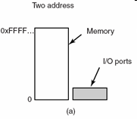
Principles of I/O Hardware
Memory-Mapped I/O
Context
Each controller has a few registers that
Can communicate with the CPU.
Allow to read and write
Many devices have a data buffer allow to read and write
→How the CPU communicates with control registers & device data buffers?
First approach
Each controller register is assigned an I/O port number, an 8/16 bit integer
The set of all the I/O ports form the I/O port space and is protected
CPU can read contents from PORT to store in REG and can write the contents from REG to PORT
→ address spaces for memory and I/O are different
Tanenbaum, Fig. 5-2.

Slide 8
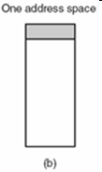
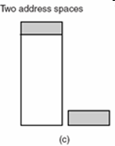
Principles of I/O Hardware
Memory-Mapped I/O
Second approach
Map all the control registers into the memory space
Each control register is assigned a particular and unique memory address (Usually, the assigned addresses are at the top of the address space)
→ memory-mapped I/O with one address space
Combination approach
A hybrid schema, with memory-mapped I/O data buffers and separate I/O ports for the control registers
Tanenbaum, Fig. 5-2.

Slide 9
Principles of I/O Hardware
Memory-Mapped I/O
How do they work?
When the CPU wants to read a word, either from memory or from an I/O port, it puts the address it needs on bus address lines and then asserts a READ signal on a bus' control line
A second signal line is used to tell whether I/O space or memory space is needed
If it is memory space, the memory responds to the request
If it is I/O space, the I/O device responds to the request.
If there is only memory space, every memory module and every I/O device compares the address lines to range of addresses that it services
If the address falls in its range, it responds to the request. Since no address is ever assigned to both memory and an I/O device, there is no ambiguity and no conflict

Slide 10
Principles of I/O Hardware
Memory-Mapped I/O
Advantages
A I/O device driver can be written entire in C (instead of using complexity assembly code)
No special protection mechanism is needed to keep user processes from performing I/O
Every instruction that can reference memory can also reference control registers (using one instruction instead of two)
Disadvantages
Caching a device control register would be disastrous (reference from cache instead of devices → disable cache is a solution)
The I/O devices have no way of seeing memory addresses as they go by on the memory bus, so they have no way of responding to them
The need of figuring out at boot time which memory addresses are not really memory addresses

Slide 11
Principles of I/O Hardware
Direct Memory Access – DMA
Problem
Disk controller reads the block from the drive serially, bit by bit, until the entire block is in the controller’s internal buffer
Disk controller computes the checksum to verify that no read errors have occurred
Disk controller interrupts the CPU to let know that those tasks are completed
CPU reads the disk block from the controller’s buffer a byte or a word at a time by executing a loop, with each iteration reading on byte or word from controller device register and storing it in main memory
→ waste the CPU’s time
Solution
Using DMA

Slide 12
Principles of I/O Hardware
Direct Memory Access – DMA
The DMA controller is integrated into each device
The DMA controller has access to the system bus independent of the CPU
The DMA controller regulates transfers to multiple devices, often concurrently
The acknowledgement is used for each DMA channel to determine the serviced device.
The DMA controller contains several registers
A memory address register
A byte count register
One or more control registers: specify the I/O port to use, the direction of the transfer (read/write from/to I/O device), the transfer unit (byte/word at a time), and the number of bytes to transfer in one burst

Slide 13
Principles of I/O Hardware
Direct Memory Access – DMA – Mechanism
Step 1
The CPU sets the DMA controller registers so DMA knows what to transfer where, and how many transfer
The CPU commands the disk controller read data from disk to internal buffer, then verify the checksum
Step 2
The DMA controller initiates the transfer by issuing a read request over the bus to the disk controller
Step 3
The disk controller transfer a word/ byte from internal buffers to main memory at the address that is described in the DMA’s memory address register
Step 4
The disk controller sends an acknowledgement signal to DMA controller when the write is complete
Simultaneously, the DMA controller decides which device to service next (using RR or priority scheme)
In each transfer, the DMA controller increments the memory addresses to use and decrements the byte count
If the byte count is still greater than 0, step 2 through 4 are repeated until the count reaches 0
If the byte equals 0, the DMA controller interrupts the CPU to let it know the transfer is now complete

Slide 14
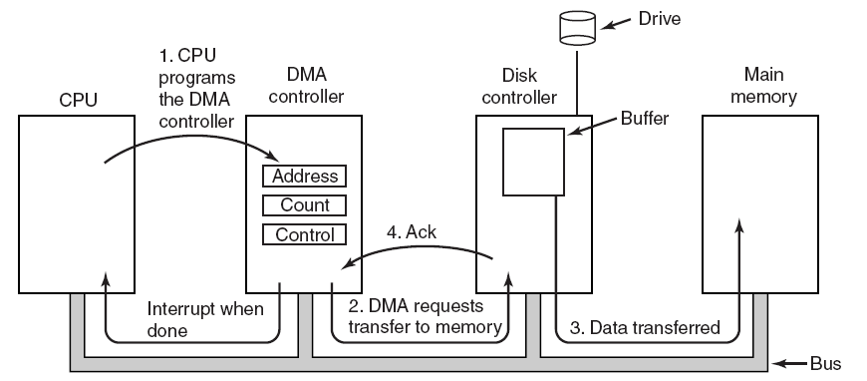
Principles of I/O Hardware
Direct Memory Access – DMA
Tanenbaum, Fig. 5-4.

Slide 15
Principles of I/O Hardware
Direct Memory Access – DMA
DMA can operate in three mode
Word-at-a-time mode
The DMA controller requests for the transfer of and gets one word
Cycle stealing: CPU has to wait the bus because device controller sneaks in and steals an occasional bus cycle from CPU
Block mode
Burst mode: DMA tells the device to acquire the bus, issue a series of transfer, then release the bus (efficiently because transfer multiple words)
Disadvantages: It can be blocked the CPU and other devices with long burst is being transfer
Fly-by mode
DMA tells the device controller to transfer the data directly to main memory
To have the device controller send the word to the DMA controller, an extra bus cycle is provided per word transfer
→ Flexible in performing device to device copies and even memory-to-memory copies (first, read to memory, then write to a memory at a different address)

Slide 16
Principles of I/O Hardware Direct Memory Access – DMA
DMA uses physical memory addresses
OS convert the virtual address of the intended memory buffer into a physical address and write this physical address into the DMA controller’s address register
Or, virtual addresses are written into the DMA controller, then DMA must use MMU to have the virtual-to-physical translation
Why does the controller need an internal buffer?
The disk controller can verify the checksum before starting a transfer (Ensuring that the errors do not occur before transferring)
Reduce the administration data in transfer when the bus were busy (then using DMA transfer because the DMA is not time critical)
Is the DMA faster or the CPU faster?
The CPU is faster and can do the job much faster when the limiting factor is not the speed of the I/O device

Slide 17
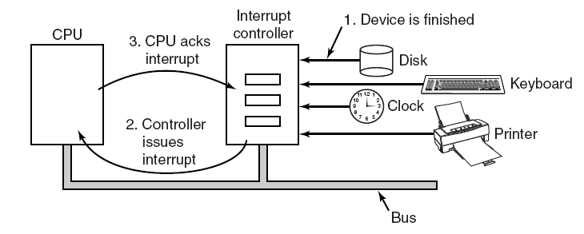
Principles of I/O Hardware
Interrupts Revisited
Tanenbaum, Fig. 5-5.

Slide 18
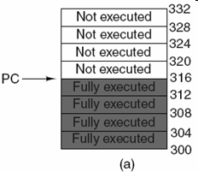
Principles of I/O Hardware
Precise Interrupts
Leave the machine in a well-defined state
There are 4 properties
PC is saved in a known place.
All instructions before the one pointed to by the PC have fully executed.
No instruction beyond the one pointed to by the PC has been executed.
Execution state of the instruction pointed to by the PC is known
There is no prohibition on instructions beyond the one pointed to by the PC from starting.
Any changes make to registers or memory must be undone before the interrupt happens
→ chip is complexity in design
Tanenbaum, Fig. 5-6.

Slide 19
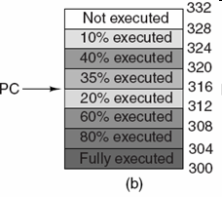
Principles of I/O Hardware
Imprecise Interrupts
Does not meet all requirements as precise
Different instructions near PC are in different stages of completions
Machines with imprecise usually vomit a large amount of internal state onto the stack to give the OS the possibility of figuring out what was going on.
→The code necessary to restart the machine is typically extremely complicated
→Saving a large mount of information to memory on very interrupts make interrupts slow and recovery even worse
Tanenbaum, Fig. 5-6.

Slide 20
Summary
Principles of I/O Hardware
Q&A

Slide 21
Next Lecture
Principles of I/O Software
I/O Software Layers

